Slide 1
PWM-PULSE WIDTH MODULATION
Dr.Sreejith Rajan

Slide 2
PWM
PWM = a method to control the average power delivered to a device by switching a digital signal ON and OFF very fast.
The “on-time” ratio (duty cycle) controls the effective output.
The frequency is high enough that the load (LED, motor, etc.) only sees a smooth average voltage.

Slide 3
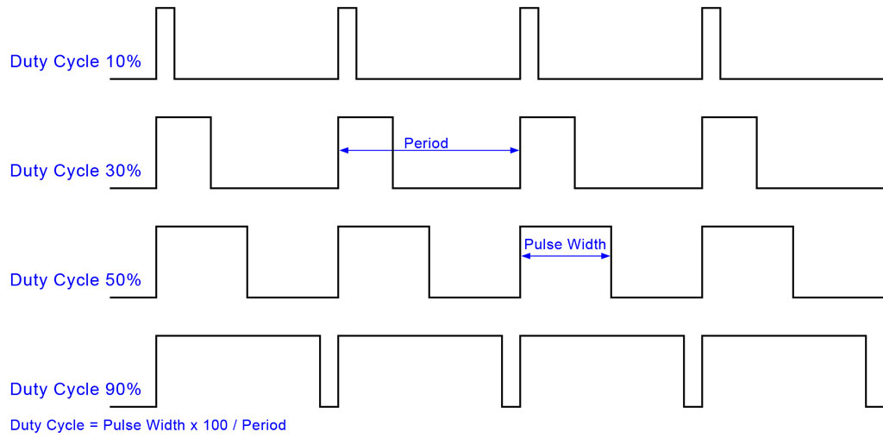
PWM

Slide 4
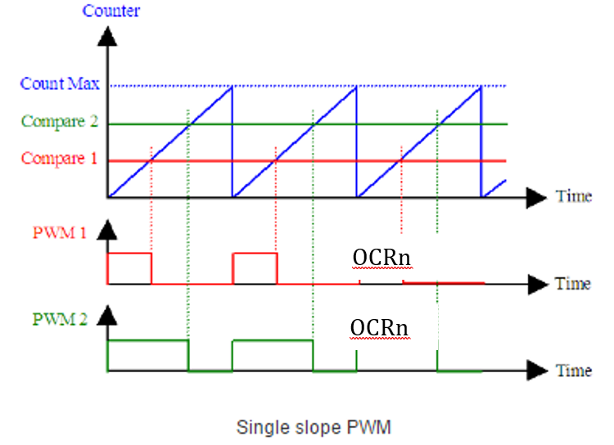
Fast PWM
F_{pwm} = F_{clk}/(N x 256); N= Prescalar

Slide 5
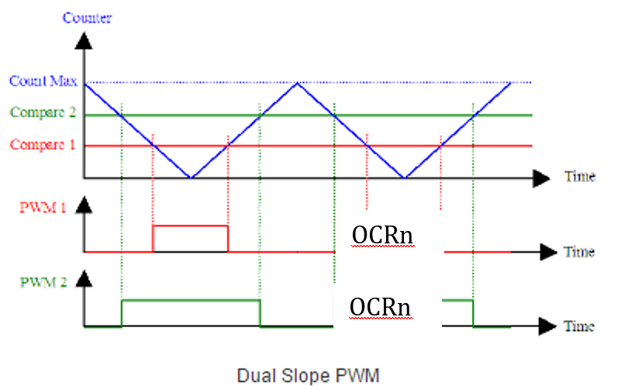
Phase Correct PWM
F_{pwm} = F_{clk}/(2xN x 256) ; N = Prescalar

Slide 6
Inverting and Noninverting PWM
Mode | COM1 | COM0 | Meaning
00 | 0 | 0 | Normal port operation (no PWM)
01 | 0 | 1 | Toggle on Compare Match (not for PWM)
10 | 1 | 0 | Non-inverting PWM
11 | 1 | 1 | Inverting PWM

Slide 7
Inverting and Noninverting PWM
// Non-inverting COM0A1 =1
TCCR0A |= (1 << COM0A1);
// Inverting COM0A1 AND COM0A0 =1
TCCR0A |= (1 << COM0A1) | (1 << COM0A0);

Slide 8
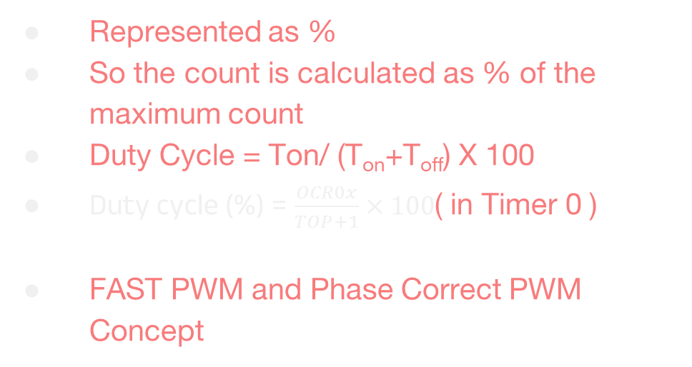
PWM duty cycle
Represented as %
So the count is calculated as % of the maximum count
Duty Cycle = Ton/ (T_{on}+T_{off}) X 100
Duty cycle (%) = $\frac{OCR0x}{TOP+1}×100$( in Timer 0 )
FAST PWM and Phase Correct PWM Concept

Slide 9
AVR Timer

Slide 10
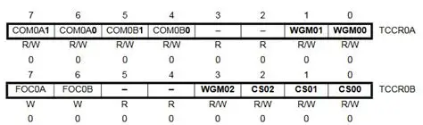
ATMEGA 328 TCCR 0

Slide 11
Let us Code

Slide 12
➔ Select appropriate PWM mode(FAST/ PHASE correct) ➔ Select inverting or non-inverting ➔Select prescalar(depending on the required PWM frequency) ➔ Set OCRx depending on the duty cycle

Slide 13
THANK YOU

